Slide 1
Fujitsu Limited
The global computer &
communications company

Slide 2



Fujitsu’s Core Business
Internet Society
Individual
Corporate
Society
Services
Platforms
Technology
Computers
Mobile devices
Networking
Transport
etc.
System Integration
Network Services
System Support
etc.
Electronic
Devices
etc.
Software

Slide 3
Software Group Products
Languages and Development Tools
Java, COBOL, C/C++, Fortran
Operating Systems
MSP/FSP for mainframes,
Linux, Solaris,
Windows
e-Business Platform
INTERSTAGE
Database / Data Warehouse
SymfoWare
Operations Management
SystemWalker

Slide 4
How does Fujitsu use Eclipse?
  As a platform for APWORKS,
    An IDE supporting Java and COBOL for the Fujitsu’s application server (INTERSTAGE).
  As a platform for the multi-platform C/C++ & Fortran application development tools.
  As a platform for the embedded Java application development tool.
  Fujitsu would announce when its participation in Eclipse is accepted
  Fujitsu will endorse Eclipse when Fujitsu’s IDE, which adopts Eclipse as an application development environment platform, is released.

Slide 5
What does Fujitsu contribute to Eclipse?
  Fujitsu will be able to develop and provide tools for Eclipse as follows:
    COBOL development tool
    Embedded Java application development tool(for mobile phone, PDA … etc.)
    Any tools related to Java
  Fujitsu will be able to contribute Eclipse customization for internationalization.
  Fujitsu will be able to contribute to improving the quality of Eclipse through the quality assurance process for our Eclipse-based products.
  Fujitsu develops products using Eclipse. The results of the testing of our products will be shared with the community.
  Fujitsu will be able to contribute to evangelizing Eclipse in Japan because of Fujitsu’s development tool customer base.

Slide 6
What is APWORKS?
APWORKS is Fujitsu’s integrated development environment for Java for developing applications on the INTERSTAGE Application Server.
APWORKS supports Java and COBOL application development from client side to Server side with the latest Java/CORBA/Web technology
Application can be developed and debugged efficiently using several APWORKS GUI tools

Slide 7
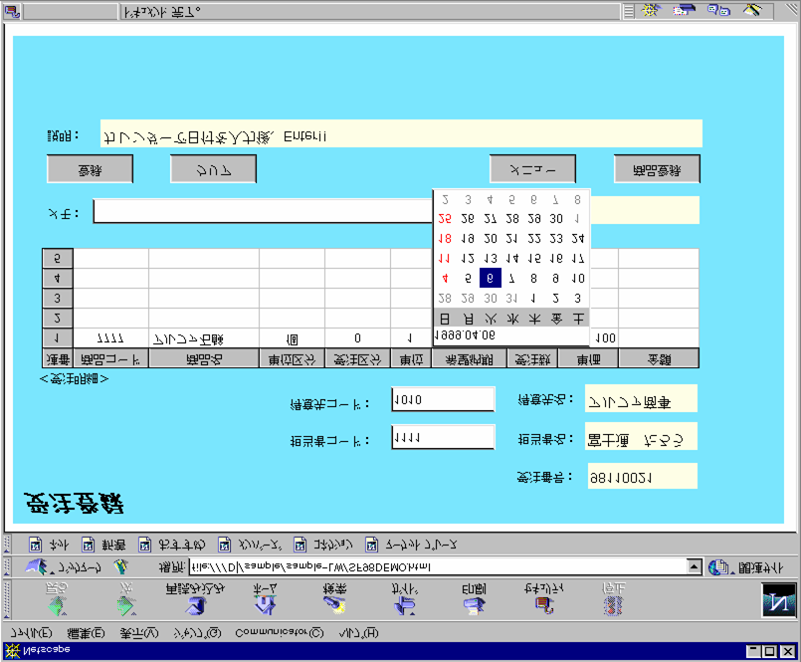
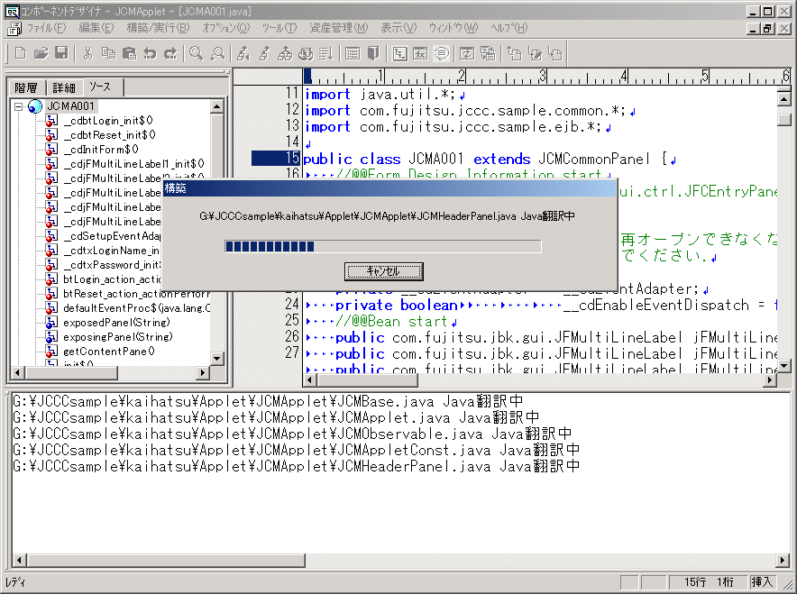
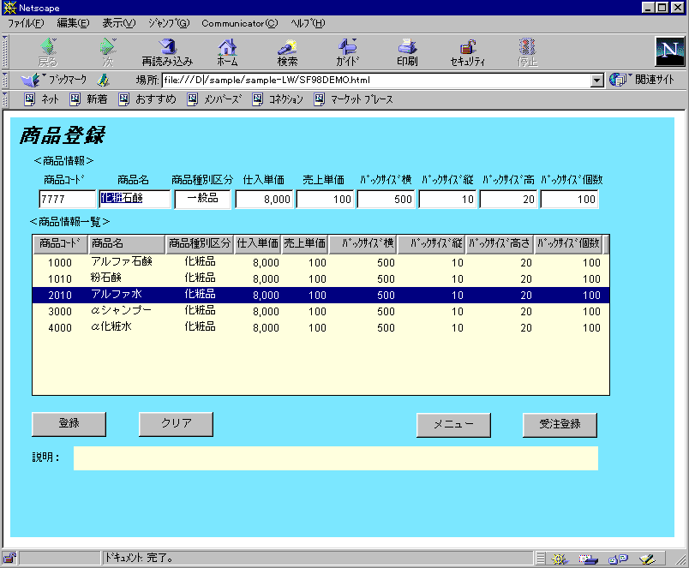
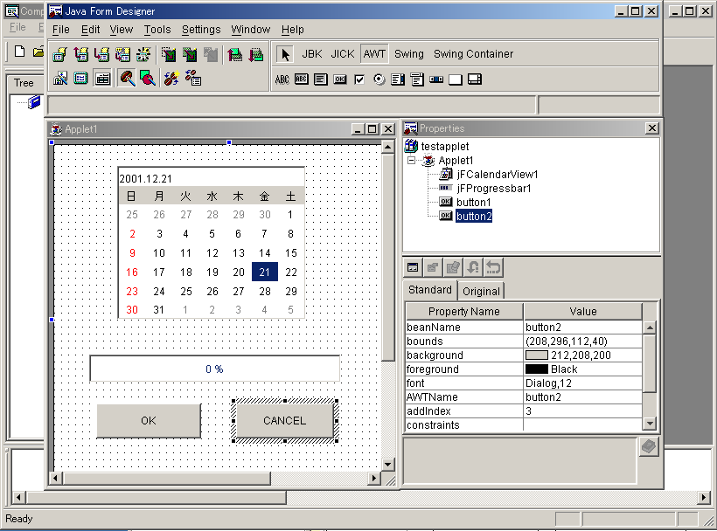
Development tools for INTERSTAGE
INTERSTAGE APWORKS
  Integrated Development Environment(IDE) for Java based on J2EE(EJB1.1)
  Supports development of application using SOAP technology
INTERSTAGE WEBCOORDINATOR
  Web Application Framework with JSP (Java Server Pages) custom tags library.
  Promotes independent Web Application, improving expandability and maintainability.
High productivity programs can be developed using wizard.
Useful GUI Components for business systems
Supports whole system development from PDAs’ applications to Server side Java Components.
Supports JDK Versions from JDK1.1 to JDK1.3.1.
INTERSTAGE APWORKS
Applets
Server Applications (Servlet、JSP、EJB、CORBA)
INTERSTAGE Application Server
INTERSTAGE WEBCOORDINATOR
Divide web application into three elements (Presentation, Data, Logic)
Support easy screen transition, easy session management
Provide rich tag library

Slide 8
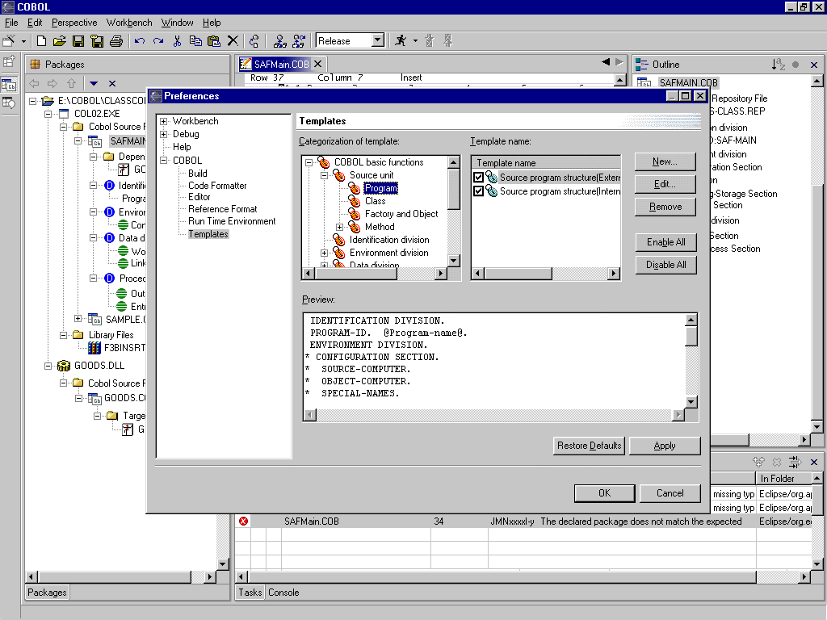
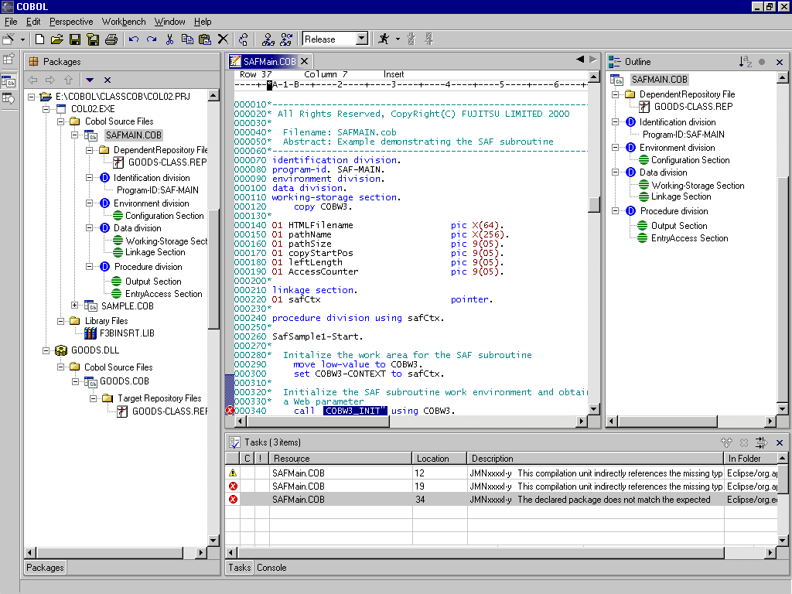
Example of COBOL Development tools built on Eclipse
Select template option under COBOL from preference dialog box where user can create/edit /remove/enable/disable syntax templates.
Categorized tree of templates & corresponding template names.
If a new Template or category is added now, it will be under this selected category.
Syntax of code shown based on template name selection, which can be edited only in edit mode
Highlighted erroneous part of the code.
On click of this error message, it jumps to the corresponding line in the editor and highlights the erroneous part of the code.

Slide 9
Ronald Alepin- Biography
Fujitsu Ltd./Fujitsu Software Corporation
    General Manager, Enterprise Products Div. ('00 to present)
      INTERSTAGE e-Business Platform
      Initiated QoEtient Internet QoS Measurement
    Factotum, Fujitsu Limited ('85 to present)
      FJ Byte-code compiler Project
      n-Tier Computing
      Mainframe Computing systems
    Software Design/Architecture & Implementation ('69 to '85)
      Operating System Software
      Security System
      Mainframe and PC distributed computing systems

